Slide 1

Signal and Image Processing (ENMR 602) Lab 1 OpenCV Libraries Dr. Moheb Mekhail moheb.mekhail@giu-uni.de Office S1.404: by appointment
TAs: | Gehad Alkady | Mostafa Hisham | Rawan Ahmad
Email: | gehad.ismail@giu-uni.de | mostafa.hisham@giu-uni.de | rawan.kadry@giu-uni.de
Office hours: | S1.213 Wed 4th | S1.211 Thurs 3rd | S1.212 Tues 3rd

Slide 2
Lecture Wrap-up:
What Is Image Processing?
Signals?
Image Processing vs. Computer Vision
Example Applications

Slide 3
What are OpenCV Libraries?
OpenCV (Open Source Computer Vision Library) is an open source computer vision and machine learning software library.
https://docs.opencv.org/4.5.5/

Slide 4
Google colab: Jupyter Notebook
More technically, Colab is a host for Jupyter notebook service that requires no setup to use, while providing free access to computing resources including GPUs.
The Jupyter Notebook App is a server-client application that allows editing and running notebook documents via a web browser. The Jupyter Notebook App can be executed on a local desktop requiring no internet access (as described in this document) or can be installed on a remote server and accessed through the internet.
Open google colab (Sign in with gmail account) → New notebook.

Slide 5
Importing image
Main Libraries:
import numpy as np #import numerical operations in python to be used as np.funcName
import cv2 # imports OpenCV2 libraries
from google.colab.patches import cv2_imshow
Libraries:
import sys
from matplotlib import pyplot as plt
import imageio

Slide 6
Importing image (cont..)
img = cv2.imread(“image”,flag) # reads an image
- image: A string representing the path of the image to be read or the name of the image Written in “”
- flag: Default ‘1’ → Colored OR IMREAD_COLOR
‘0’ → grey of image OR IMREAD_GRAYSCALE
cv2_imshow(img) # displays the image "img”
typically cv.imshow(img) → incompatible with jupyter so we must import cv2_imshow first

Slide 7
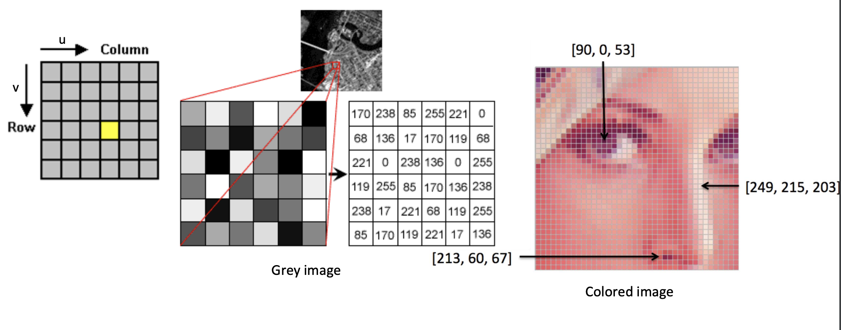
Digital Image
print(img[50:100,50:100]) # prints the values of all the pixels in the image

Slide 8
Show image size
print(img.shape) # print the n dimensional image size: pixels in height, pixels in width and number of channels
Alternatively
(height, width,channels) = img.shape
print (height,width,channels)

Slide 9
Converting image into grayscale
img_grey = cv2.imread("download.png",0) #by using the flag argument to be zero as mentioned previously
Alternatively
img_grey = cv2.cvtColor(img,code)
- path → image file
- code: cv2.COLOR_BGR2GRAY , cv2.COLOR_BGR2RGB
- See documentation for other usable codes
print(img_grey.shape) #both lines should be written after taking any step of editing your image
cv2_imshow(img_grey)

Slide 10
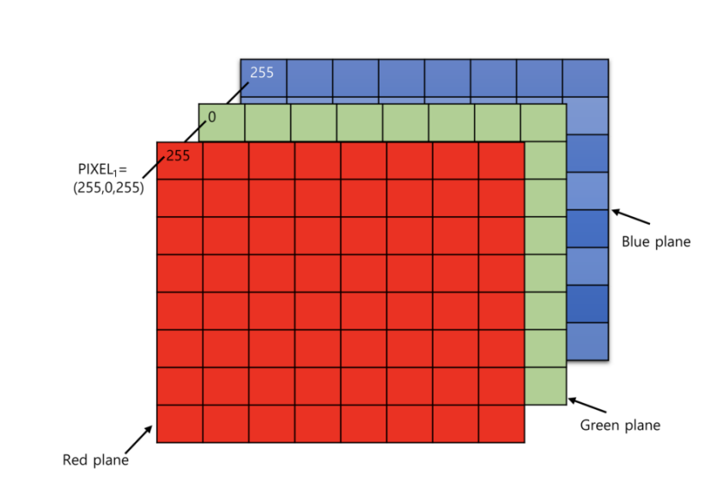
Color planes
Standard color planes order: RGB
OpenCV color planes order: BGR
Splitting the images into its planes
(B, G, R) = cv2.split(img) # splits the image into Blue, Green and Red planes
Alternatively
red = img[:,:,2] #extract the plane from the image matrix 0 for blue, 1 for green and 2 for red
cv2_imshow(red)
Merging the planes into the image
merged = cv2.merge([B, G, R]) #to merge the three panels again

Slide 11
Image Cropping
img2 = img[50:100,50:100] # creates a new image with a specific part from the old image by specifying the range of the selected pixels in height and width
cv2_imshow(img2)

